Slide 1
DATABASE ARCHITECTURE AND THE WEB Session 3
Course : ISYS6280 – Database Systems (GAT)
Year : 2017

Slide 2
LEARNING OUTCOME
LO 1 : Describe database systems, terminology, environment, and new concept of database

Slide 3
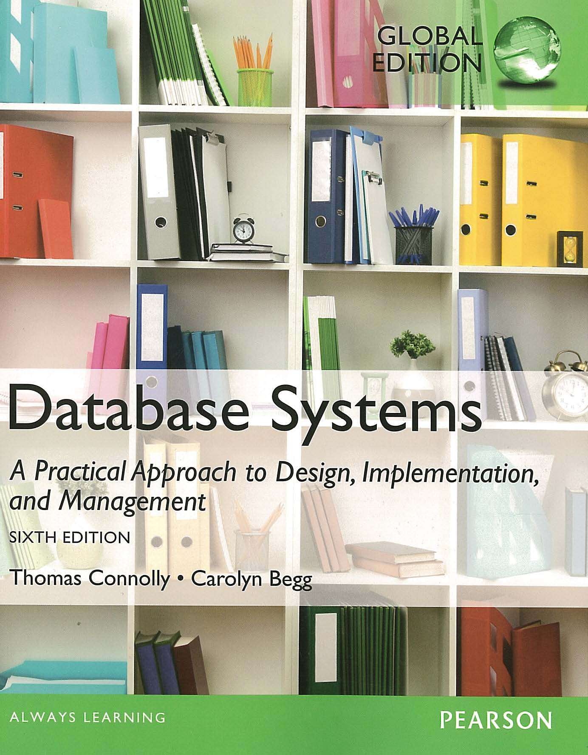
ACKNOWLEDGEMENT
These slides have been adapted from Thomas Connolly and Carolyn Begg. 2015. Database Systems: A Practical Approach To Design, Implementation, and Management. Pearson Education. USA. ISBN:978-1-292-06118-4

Slide 4
CHAPTER 3 DATABASE ARCHITECTURE AND THE WEB

Slide 5
LEARNING OBJECTIVES
The meaning of the client–server architecture and the advantages of this type of architecture for a DBMS.
The difference between two-tier, three-tier and n-tier client–server architectures.
Function and uses of Transaction Processing Monitors.
The purpose of a Web service and the technological standards used to develop a Web service.
The meaning of service-oriented architecture (SOA).
The architecture of a data warehouse.

Slide 6
Multi-user DBMS Architectures
The common architectures that are used to implement multi-user database management systems:
Teleprocessing
File-Server
Client-Server

Slide 7
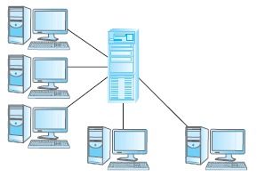
Teleprocessing
One computer with a single CPU and a number of terminals.
Processing performed within the same physical computer. User terminals are typically “dumb”, incapable of functioning on their own, and cabled to the central computer.

Slide 8
File-Server
File-server is connected to several workstations across a network.
Database resides on file-server.
DBMS and applications run on each workstation.
Disadvantages include:
Significant network traffic.
Copy of DBMS on each workstation.
Concurrency, recovery and integrity control more complex.

Slide 9
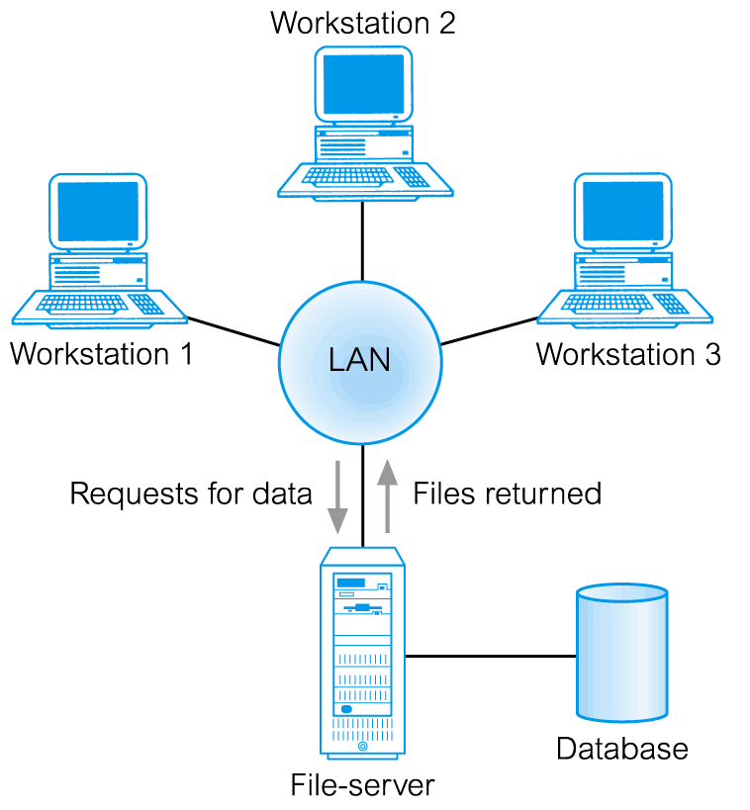

File-Server Architecture
In a file-server environment, the processing is distributed about the network, typically a local area network (LAN).

Slide 10
Traditional Two-Tier Client-Server
Client (tier 1) manages user interface and runs applications.
Server (tier 2) holds database and DBMS.
Advantages include:
wider access to existing databases;
increased performance;
possible reduction in hardware costs;
reduction in communication costs;
increased consistency.

Slide 11
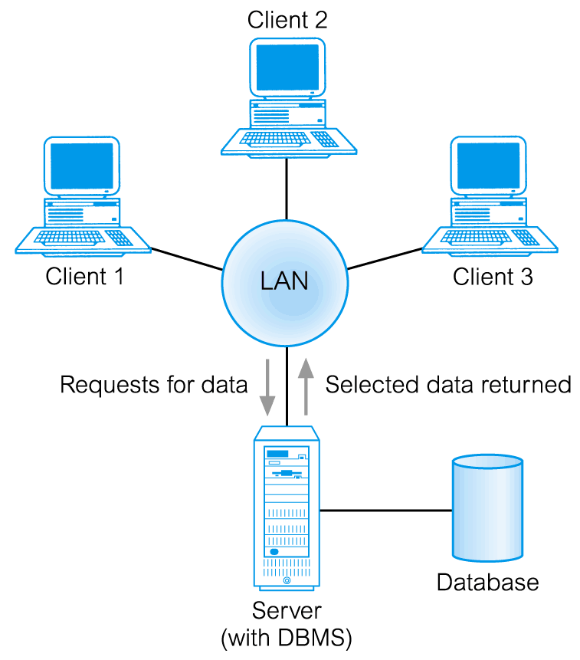
Traditional Two-Tier Client-Server Architecture

Slide 12
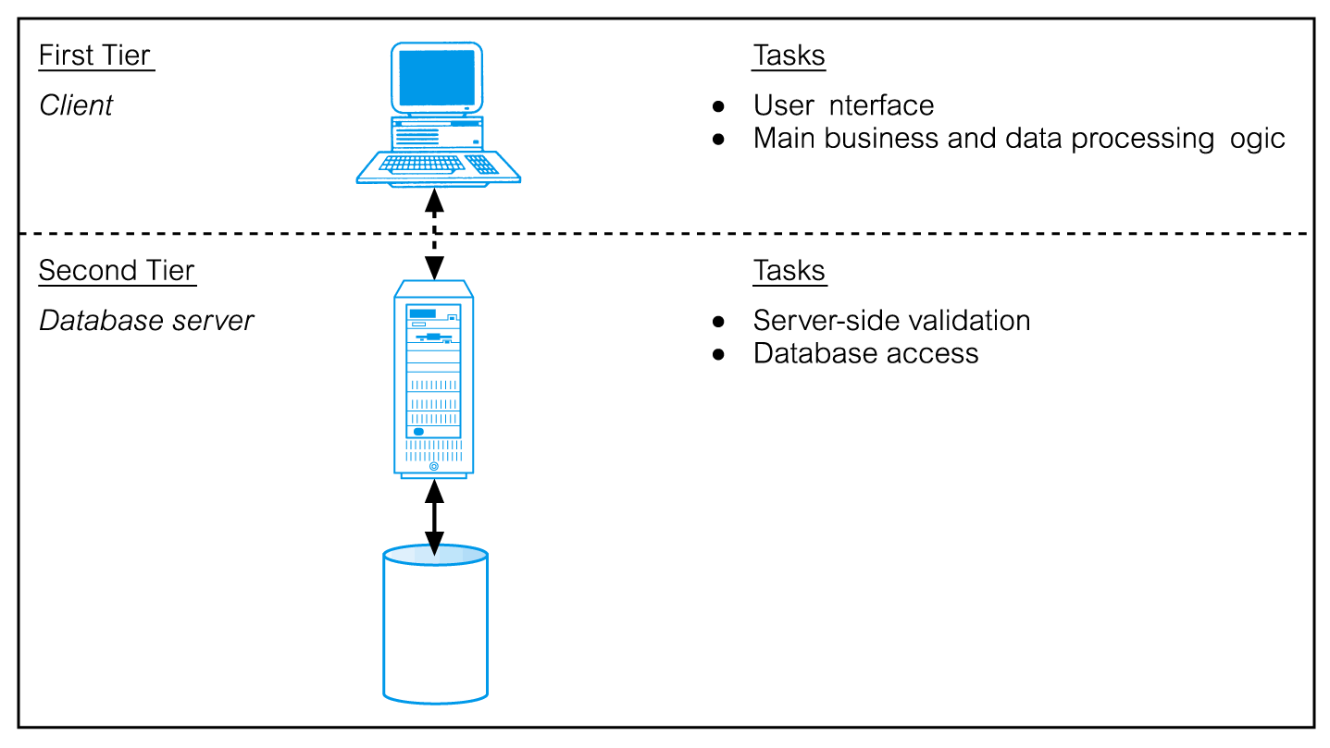
Traditional Two-Tier Client-Server

Slide 13
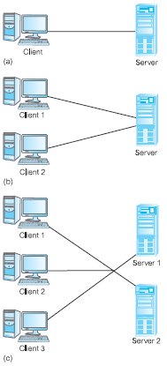
Alternative Client-Server Topologies

Slide 14
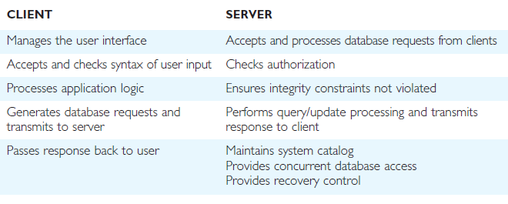
Summary of Client-Server Functions

Slide 15
Three-Tier Client-Server
The need for enterprise scalability challenged the traditional two-tier client–server model.
Client side presented two problems preventing true scalability:
‘Fat’ client, requiring considerable resources on client’s computer to run effectively.
Significant client side administration overhead.
By 1995, three layers proposed, each potentially running on a different platform.

Slide 16
Three-Tier Client-Server
Advantages:
‘Thin’ client, requiring less expensive hardware.
Application maintenance centralized.
Easier to modify or replace one tier without affecting others.
Separating business logic from database functions makes it easier to implement load balancing.
Maps quite naturally to Web environment.

Slide 17
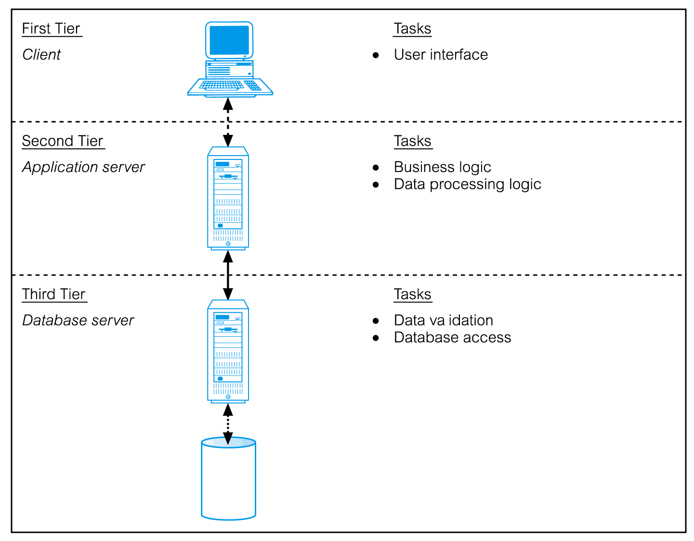
Three-Tier Client-Server

Slide 18
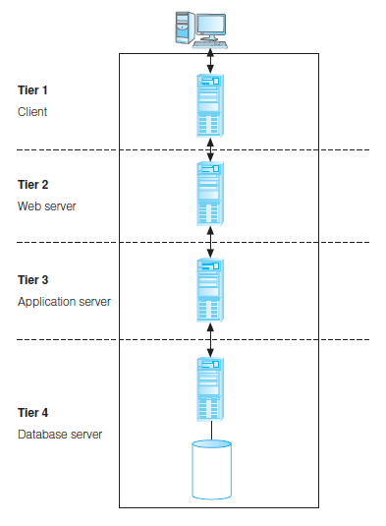
n-Tier Client-Server (e.g. 4-Tier)
The three-tier architecture can be expanded to n tiers, with additional tiers providing more flexibility and scalability.
Applications servers host API to expose business logic and business processes for use by other applications.

Slide 19
Middleware
Middleware is a generic term used to describe software that mediates with other software
Communication among disparate applications
Six main types
Asynchronous Remote Procedure Call (RPC)
Synchronous RPC
Publish/Subscribe
Message-Oriented middleware (MOM)
Object-request broker (ORB)
SQL-oriented data access

Slide 20
Transaction Processing Monitors
Controls data transfer between clients/servers
Provides a consistent environment, particularly for online transaction processing (OLTP)
Significant advantages
Transaction routing
Managing distributed transactions
Load balancing
Funneling
Increased reliability

Slide 21
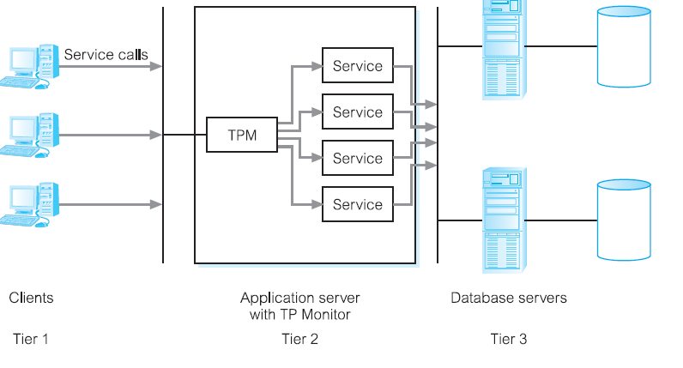
Transaction Processing Monitor as middle tier of 3-tier client-server

Slide 22
Web Services and Service-Oriented Architectures
Software system designed to support interoperable machine-to-web service machine interaction over a network.
Web services share business logic, data, and processes through a programmatic interface across a network.
Developers can add the Web service to a Web page (or an executable program) to offer specific functionality to users.

Slide 23
Web Services and Service-Oriented Architectures
Web services approach uses accepted technologies and standards, such as:
XML (extensible Markup Language).
SOAP (Simple Object Access Protocol) is a communication protocol for exchanging structured information over the Internet and uses a message format based on XML. It is both platform- and language-independent.
WSDL (Web Services Description Language) protocol, again based on XML, is used to describe and locate a Web service.

Slide 24
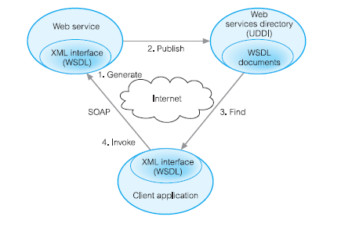
Web Services and Service-Oriented Architectures
UDDI (Universal Discovery, Description, and Integration) protocol is a platform independent, XML-based registry for businesses to list themselves on the Internet.

Slide 25
Service-Oriented Architectures (SOA)
Architecture for building applications that implement business processes as sets of services
Published at a granularity relevant to the service consumer
Loosely coupled and autonomous services
Web services designed for SOA different from other Web services.

Slide 26
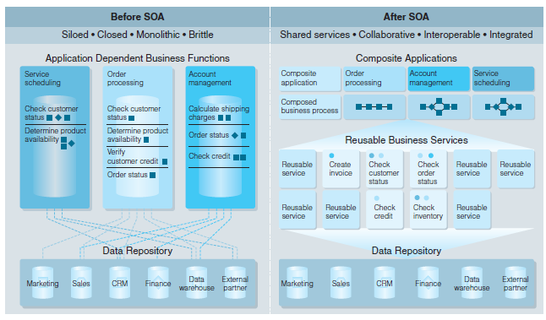
Traditional vs. SOA Architecture

Slide 27
Data Warehousing
Data warehouse
Consolidated/integrated view of corporate data
Drawn from disparate operational data sources
Range of end-user access tools capable of supporting simple to highly complex queries to support decision making
Subject-oriented, integrated, time-variant, and nonvolatile

Slide 28
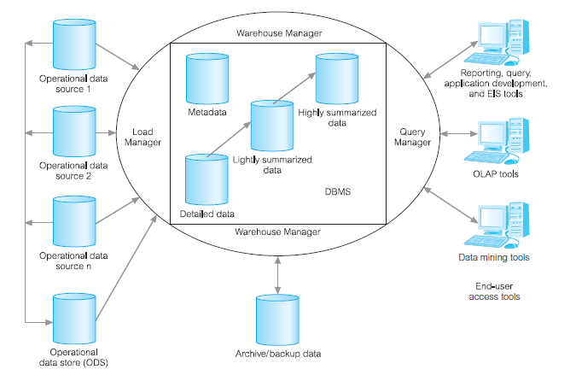
Typical Architecture of a Data Warehouse

Slide 29

www.healthytravelblog.com

